Slide 1
Predicting Nigerian Property Prices:
A Machine Learning Approach

Slide 2
The Business Problem and Data Overview
The Problem: House prices in Nigeria are highly volatile and influenced by factors beyond simple physical size.
Our goal is to build a predictive model to understand which features truly drive valuation.
Our Data Scope (df.shape):24,326 Property Listings (Observations)8 Features (e.g., bedrooms, state, price)
Key Features Selected for Modeling: bedrooms, bathrooms, toilets, parking_space, title, and state.

Slide 3
Tackling Data Challenges (Mandatory for Model Integrity)
Challenge A: Extreme Outliers Evidence:
The raw data showed a massive imbalance (e.g., Average Lagos Price was N345M vs. Median of N95M). This was due to ultra-luxury/erroneous listings.
Using the Interquartile Range (IQR) method on the log transformation for the price to filter and remove these extreme values..

Slide 4
Tackling Data Challenges (Mandatory for Model Integrity)
Challenge B: Data Skewness Evidence:
The raw price distribution was heavily skewed to the right (many low prices, few high prices).
Applied Log Transformation of price. This step normalized the data, which is mandatory for a Linear Regression model.

Slide 5
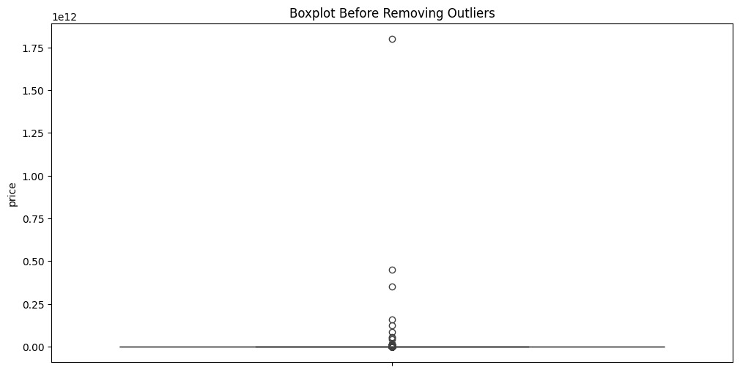
Tackling Data Challenges (Mandatory for Model Integrity)

Slide 6
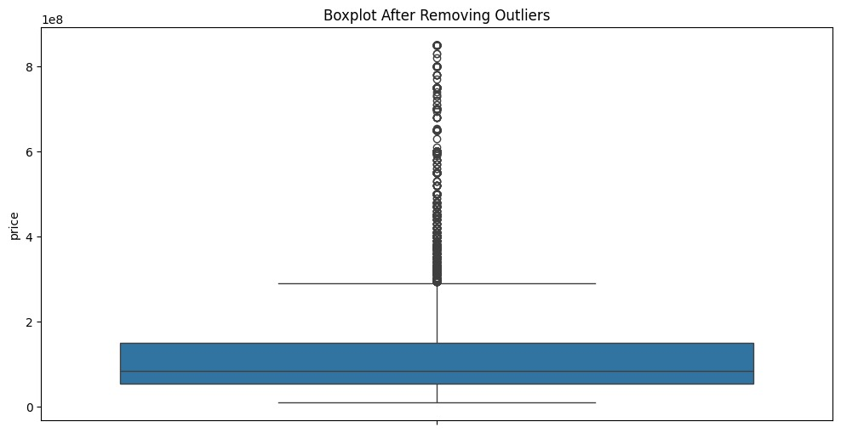
Tackling Data Challenges (Mandatory for Model Integrity)

Slide 7
Market Concentration (State Summary)
Key Finding
Lagos: Dominates the market (over 75% of listings).
Abuja: Second major market (approx. 15% of listings).
Insight
Property value is highly concentrated in these two states, confirming that Location is the strongest initial factor.

Slide 8
Model Training & Diagnostics

Slide 9
Initial Model & Major Flaw
Model Used: Linear Regression (the starting point).
The Initial Flaw: The coefficients were highly unstable and untrustworthy due to an issue called Multicollinearity.
Diagnosis Tool: Variance Inflation Factor (VIF).Initial Problem Evidence: VIF for state.
Lagos was 464, far above the acceptable threshold of 10.

Slide 10
Solving Multicollinearity
What is Multicollinearity: Features are redundant (e.g., bedrooms and bathrooms measure the same "size" concept).
Action Taken: Iteratively removed the feature with the highest VIF: state_Lagos.
Result (Post-Correction): All remaining VIF scores dropped to below 6. The model became stable (coefficients were now reliable).

Slide 11
Feature Relationships
(Pair-plot Visual)
Visual Evidence:
Rooms vs. Price: Confirmed a positive, linear relationship between room counts and log transformation for price.
Rooms vs. Rooms: Clearly showed the tight, positive correlation between bedrooms and bathrooms (the root cause of the VIF problem).

Slide 12
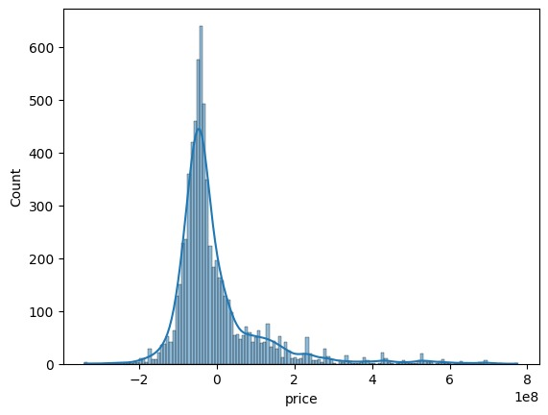

Slide 13
Results, Conclusion, and Recommendation

Slide 14
Final Linear Regression Performance
Goal: Predict house price.
Performance Metrics:
Mean Absolute Error (MAE): 64,921,953 (Prediction is off by 65 million on average).
R-squared Score: {0.1827} (18.27%)
Despite extensive cleaning and VIF correction, the is too low. The model only explains18 of the price variance, making it unacceptable for reliable price prediction.

Slide 15
Key Insights: The Reliable Coefficients)
State Impact (Negative Coefficients): The model confirms that most states have a significantly lower price impact compared to the reference (Lagos/Abuja).
Strongest Negative Drivers: Plateau, Cross River, Kwara.
Property Type Impact: Property types like Detached Bungalow and Semi-Detached Bungalow also exert a strong negative pressure on the price compared to Block of Flats or Detached Duplexes.
The Pule

Slide 16
Recommendation & Future Work
The Model is Wrong, Not the Data: The poor R-Square is not a data problem, but a Model Selection Problem. House pricing is a highly non-linear problem.
Recommendation: Move to a Non-Linear Model.

Slide 17
Recommendation & Future Work
New Target Model:
Random Forest Regressor or Gradient Boosting Regressor.
Why: These models do not require VIF checks and are superior at capturing complex, non-linear feature interactions, which should push the R-square significantly higher (0.70).
Future Feature Engineering: Include features like Town/Neighborhood, Age of House, and Amenities for a more accurate model.

Slide 18


State Level Impact
Conclusion
Human Cost
The End
Recommend
Welcome
Line Chart
Progress
Causes
The Pulse
The Data
The Journey
Hardest Crashes
Affected
Fatalities

